Slide 1


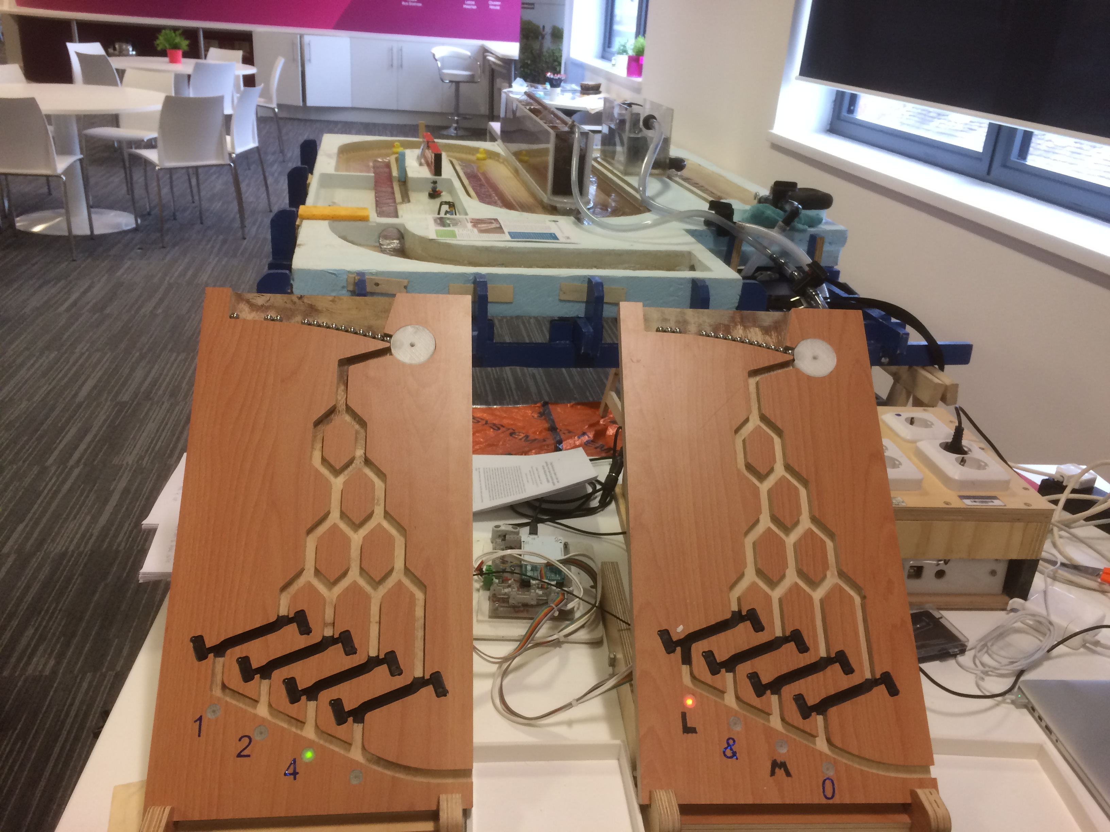
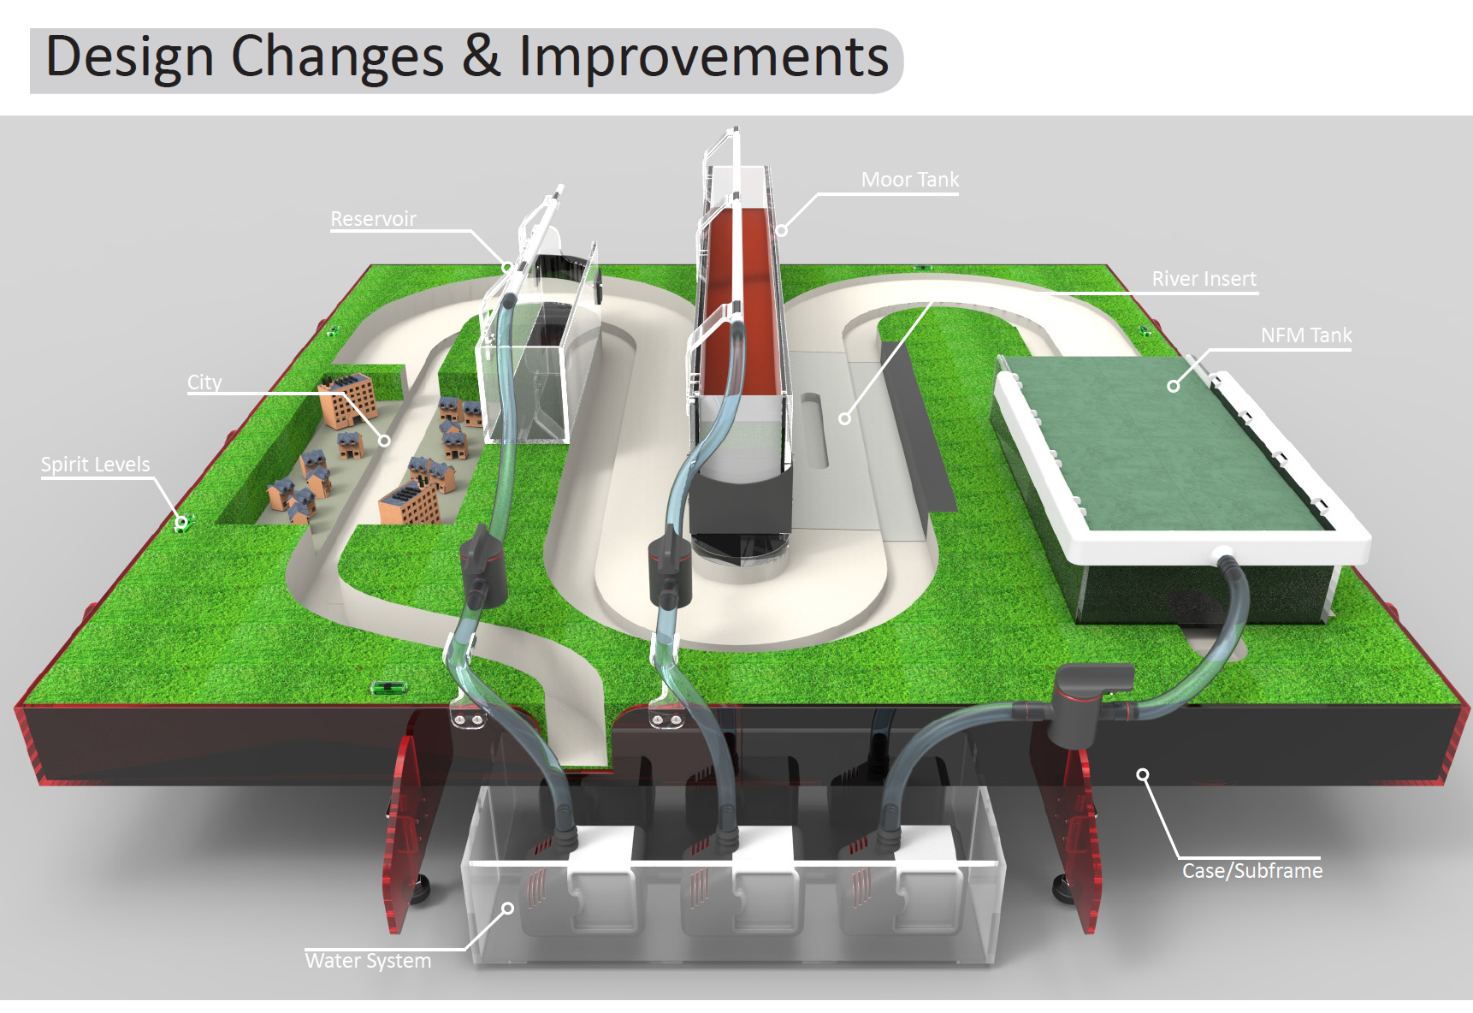
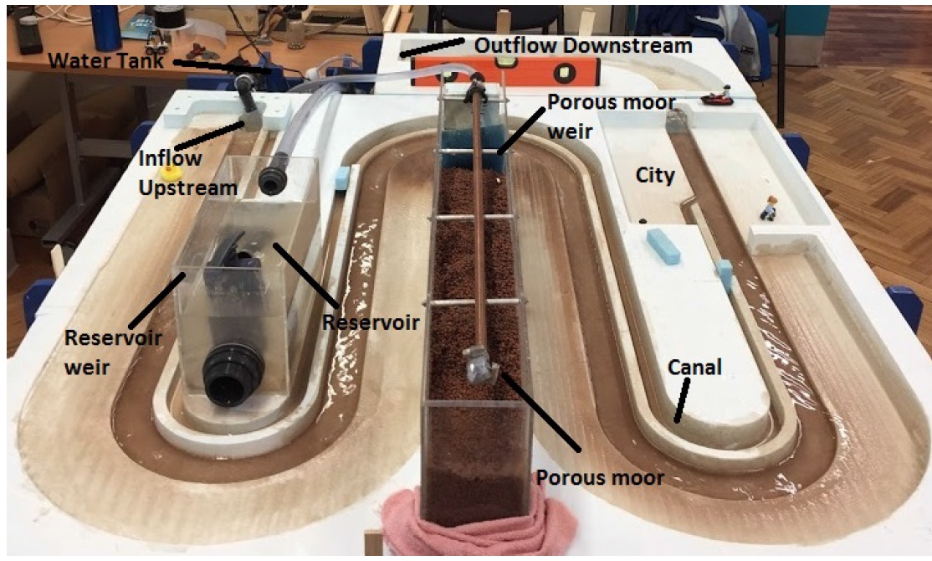
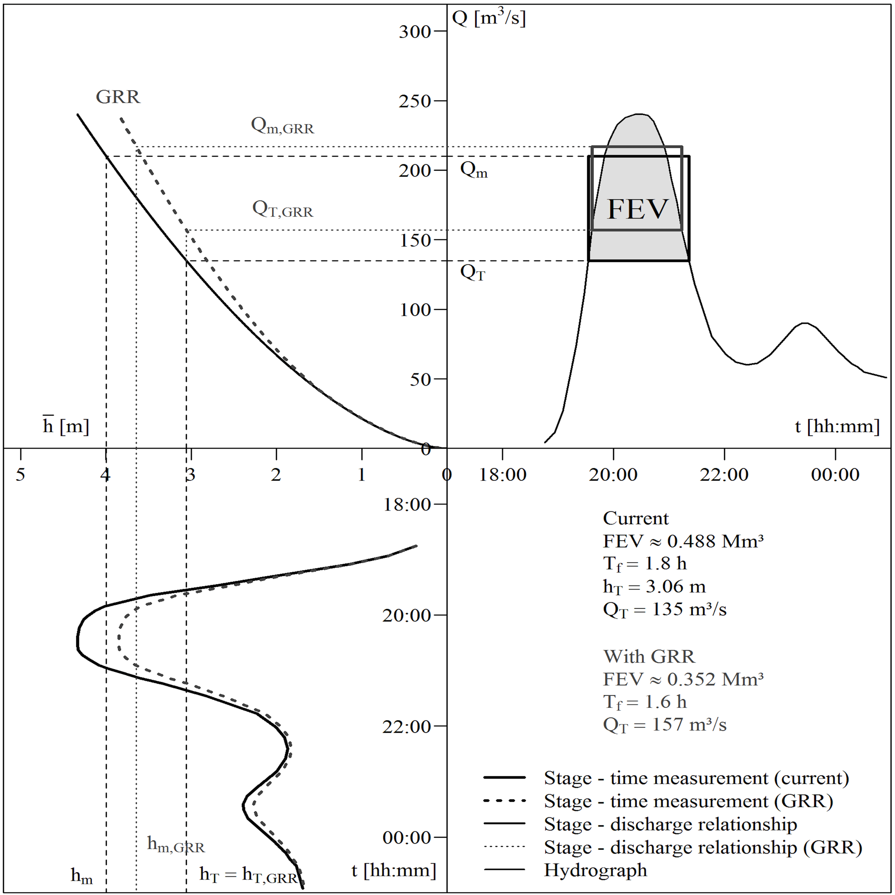
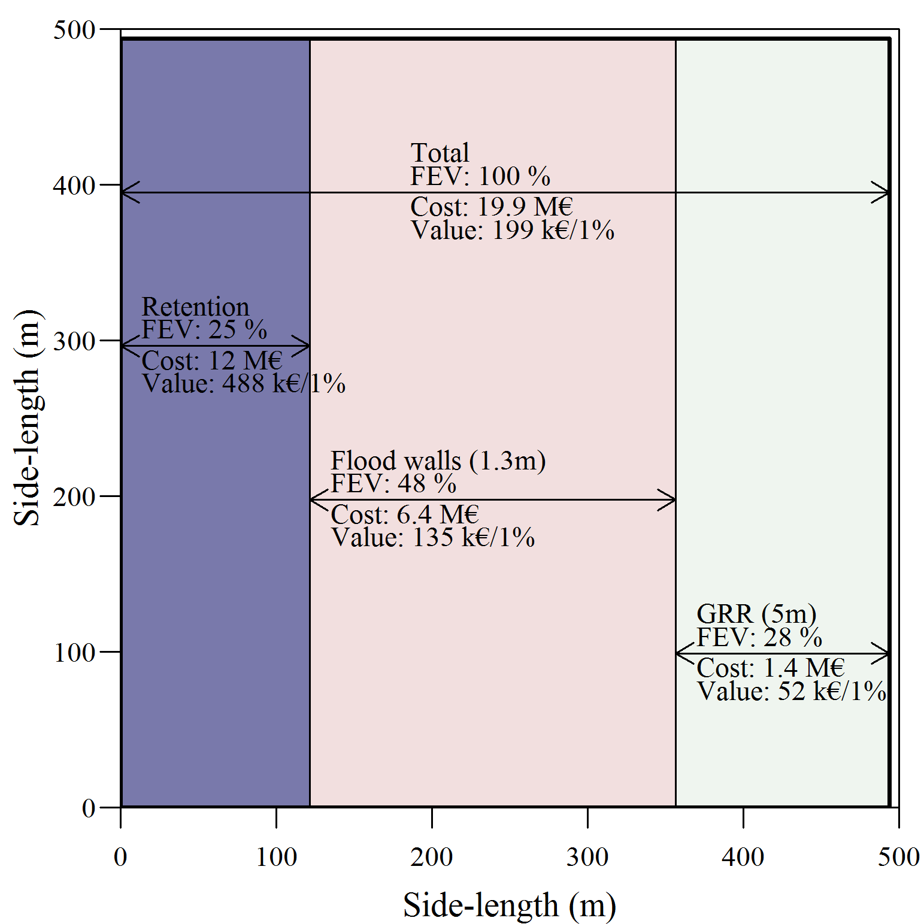
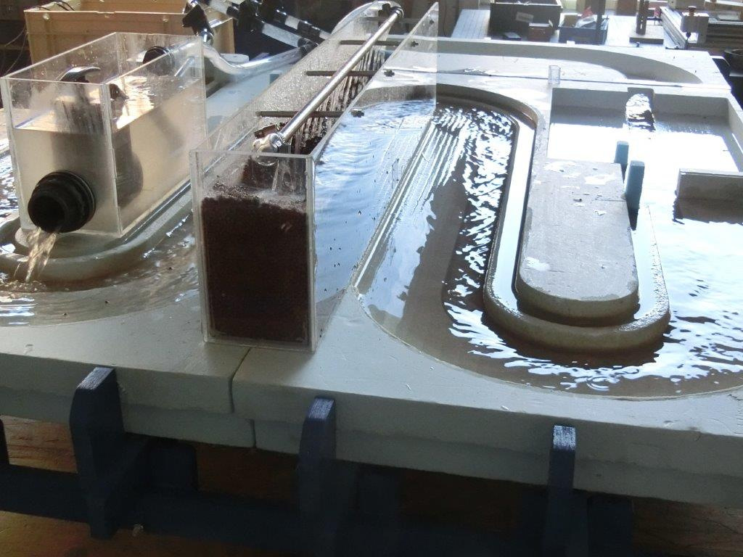
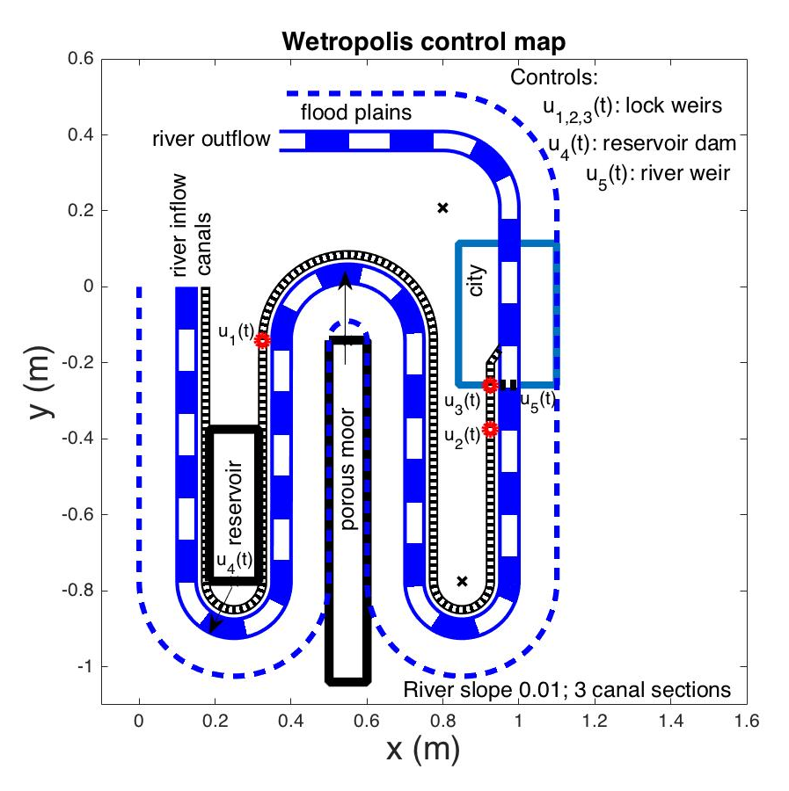
Wetropolis: models for education & water-management of floods and droughts Onno Bokhove¹, Tom Kent¹, Henk de Poot² and Wout Zweers³ ¹School of Mathematics, University of Leeds, Leeds, UK; ²Nobis & ³Wowlab, Enschede, The Netherlands
Mathematics of extreme rainfall/flood demonstrator
Education & water-management
Wetropolis interactive flood demonstrator is based on a mathematical design and visualises how extreme rainfall events can cause extreme river-flood events in a dynamic, conceptual and scaled table-top set-up. Galton boards are used to model different rainfall scenarios over the course of a Wetropolis day (wd=10 seconds) and extreme flooding in a city by rainfall on the current and previous days, as in the real world [1].
Droughts: to visualise drought for the 1/16th route of a dry day, we use the outcome of the first Galton board (not used without rainfall) after 2 pins with (3,1)/4 probability. For the 1/4-case, we enforce drought for 4 days, visualised by a drinkwater pipe from the moor falling dry: no water supply! New proba-bilities then adjust to: (12,28,20,3,4)/67 for rainfall in reservoir, moor & reser-voir, moor, no rain on single day & no rain for 4 days. Drought return period: 67x10s=11:10min. New flooding return period: (16x67/28)x10s=6:23min.
Overview, modelled after Leeds’ Boxing Day flood 2015 (1:300yr return-period event):
1:100 sloped river bed; Wetropolis day 10s; upstream inflow; with canal, reservoir/lake & porous groundwater moor draining into river;
chance of rare flood event in city after 90% rainfall (9s/wd) is (1/16)x(7/16)=7/256 with a (256/7)x10s=6:06min return period.
Modular design: we are currently making a Wetropolis NFM demonstrator with
participant-built leaky dams in oasis-landscape; and,
river-bed inserts of different roughness (“trees, cement, gravel”).
NFM = Natural Flood Management.
Galton boards: steel balls travel down and land in 1 of 4 columns with at each junction a 50% chance of ball going left or right. Galton boards randomly determine: (i) rainfall amount (columns: 1s, 2s, 4s, or 9s) and (ii) rainfall location (columns: lake/reservoir, moor & reservoir, moor, or no rainfall). Probability asymmetric Galton board: (3,7,5,1)/16. Plan view:
Promote active thinking about different scenarios of flood/drought mitiga-tion: Wetropolis is useful precursor in creation [2] of water-management solutions; also enhances citizens’ participation. Wetropolis led to flood-excess-volume based cost-effectiveness analysis, e.g., River Brague flood
2015, France [3]:
Wetropolis is designed to flood (right) under extreme rainfall (9s/wd) in moor & reservoir; two consecutive wd’s of extreme rainfall lead to a chance of (7/256)² <1%; cf. Boxing-Day flood 2015, see; https://youtube.com/watch?v=N4Sp5gHXcz4
“Wetropolis: making tangible, interactive models for education & policy” is an EFRO RD consortium (EU fund for regional development), led by Nobis, Dr Henk de Poot, henkdepoot@nobis.pro
References
[1] Bokhove et al 2019: Wetropolis paper & design. https://github.com/obokhove/wetropolis20162020
[2] Poot, de, et al 2019: Wetropolis EU project. https://www.wetropolis.nl/
[3] Bokhove , Kent, Kelmanson, Piton, Tacnet 2018: https://eartharxiv.org/87z6w/ (subm RRA);
BKK: https://eartharxiv.org/stc7r/ & BKK: https://eartharxiv.org/w9evx/

